Slide 1
Programming Fundamentals in C++
(Practical#01)

Slide 2
Objective: Installation of Turbo C++, Dev-C++ IDEs, To become familiar with Basic C++ Program structure and Programming syntax
Program statements /Program instructions and a computer Program
Syntax
Source code and object code , source file and object file
Executable file
Language Translators (Assembler, Compiler, Interpreter)
Escape Sequence

Slide 3
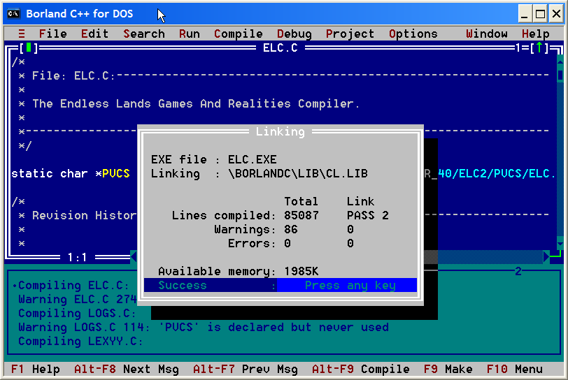
Borland Turbo C++ IDE (Integrated Development Environment)

Slide 4
What is an IDE (Integrated Development Environment) ?
An integrated development environment (IDE) is a software application that provides comprehensive facilities to computer programmers for software development.
Borland first introduced Turbo C++ in 1990. Turbo C++ provides an environment called IDE (Integrated Development Environment). The IDE/editor is used to create the source file, compile it, link it and then execute it.
Turbo C++ is an IDE It provides us the facility to create, edit, delete, run, compile, and debugging the programs.
An IDE normally consists of a source code editor, Compiler, build automation tools, and a debugger.

Slide 5
Computer programming: Is a way of giving computers instructions about what they should do next. These instructions are known as code, and computer programmers write code to solve problems or perform a task.
Computer programming is the process of designing and building an executable computer program for accomplishing a specific computing task.
Computer programming is the skill of writing useful, source code which can be interpreted or compiled by a computing system to perform a meaningful task.

Slide 6
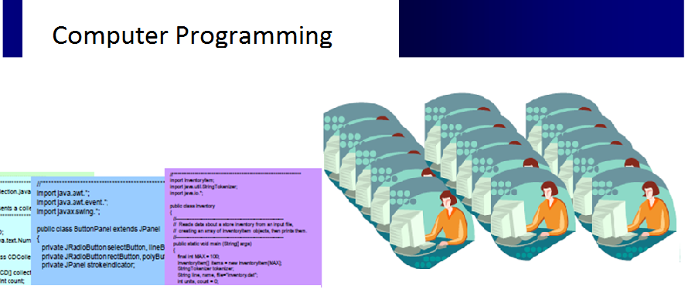

Slide 7
Computer Programming and Computer Program
The process of developing and implementing various sets of instructions to enable a computer to do a certain task (Computer Programming)
These instructions are considered computer programs.

Slide 8
A computer program is a list of instructions
that tell a computer what to do.
Everything a computer does is done by using a computer program.
Some examples of computer programs are:
A web Browser like Mozilla Firefox and Google Chrome can be used to view web pages on the Internet. and
Office suite can be used to write documents or spreadsheets.
Video games are computer programs.

Slide 9
A computer program is written in a
Programming Language.
Computer Programming can be performed in one of numerous languages, ranging from
Machine Language for machines (i.e. computers)
to writing directly in Low-level machine code (that is, code that more directly controls the specifics of the computer's hardware).
a Higher-level language

Slide 10
Some Examples of High Level Programming Languages
Programmers make use of specific computer languages like :
C, C++, Java, PHP, .NET, etc. to convert the program designs developed by software developers or system architects into instructions that the computer could follow.
Computer programming is one part of a much larger discipline known as software engineering, which includes several different aspects of making software including design, construction and quality control.

Slide 11
Computer Software
Computer software (often called just software) is a set of instructions and associated documentation that tells a computer what to do or how to perform a task or it can mean all the software on a computer, including the
Application Softwares and the
Operating system.
Applications are programs that do a specific thing, such as a word processor.
Operating system (Mac OS, Microsoft Windows, Linux, etc.) is software that helps the applications run, and controls the display and the keyboard.

Slide 12
Introduction to C++
C++ is a High-Level Language
Easy for the Programmers to understand.
Contains English Words.
It is in the form of text.
It is human readable.
It is input to the language translator.

Slide 13
Introduction to C++
Program statements /Program instructions
A C++ program consists of a set of statements.
A computer program is a list of instructions written to perform a specified task with a computer.
Instruction is any command given to the computer.
For example:
1)Display a Message Cout <<“Hello World.” ; Each of these is the individual instruction to the computer.
2)Add two variables A and B int SUM=A+B;

Slide 14
Anatomy of a C++ Program
#include<iostream.h>
void main()
{
}
Required part of Every C++ Program

Slide 15
Anatomy of a C++ Program
#include<iostream>
#include<conio.h>
void main()
{
cout<<“Hello Wrold. ";
getch();
}
File program.cpp

Slide 16
#include Is a pre-processor directive.
< iostream.h > Is a Header File.
The main() is the name of the function.
Every function name is followed by ( ) parenthesis
Every C++ program must contain at least one function i.e. main() function.

Slide 17
main() function
main() function is the Entry point / gateway of a C++ program. because every program starts from the main function.
The curly brackets { and } specify the starting and ending of the function.

Slide 18
Outputting with cout (console out)
In C++, cout is the Standard Output Stream.
In C++, cout statement is used to print/display the text or numbers on the monitor screen.
cout is used in conjunction with the insertion operator (<<) or put-to-operator.
Any thing on the right side of << will be displayed on monitor screen.

Slide 19
Outputting with cout
“Hello World.” is the string literal / constant to be displayed.
;(semicolon)is called as terminator, it shows the end of any statement.

Slide 20
getch() function
In order to view the output we used getch() function.
getch( ) is used to hold the output screen
The getch() function is used to get one character from the keyboard.
Whenever the computer encounters getch() function, it will wait for the user to press any key from the keyboard.
Once the user presses any key on the keyboard that will be get by the getch() function.

Slide 21
<conio.h> Header File is required for getch() function.
conio.h contains prototype/declaration for getch() function.
conio.h header used in C++ programming contains functions for console input/output.
Some of the most commonly used functions of conio.h are clrscr, getch, getche, kbhit etc.
Functions of conio.h can be used to clear screen, change color of text and background, move text, check whether a key is pressed or not and many more.

Slide 22

Introduction to C++
cout << “Batch 24BSAI ”;
Do this

Slide 23
Introduction to C++
Program: is a set(collection) of instruction to do a meaningful task.
A computer program is stored as a file on the computer's hard drive.
When the user runs the program, the file is read by the computer, and the processor reads the data in the file as a list of instructions. Then the computer does what the program tells it to do.

Slide 24
Introduction to C++
Syntax: Syntax is the grammatical structure of sentences.
The format in which words and phrases are arranged to create sentences is called syntax.
Preset Continuous Tense

Slide 25
Introduction to C++
Syntax: way of writing.
The structure of statements in a computer language.
A set of rules for a Computer language.
Every Programming Language has its own Syntax

Slide 26
Anatomy of C++ basic program

Slide 27
Anatomy of C++ basic program
“Welcome 24BSAI”

Slide 28
Source code and object code
A program written in high-level language is called a source code. We need to convert the source code into machine code and this is accomplished by compilers and interpreters.
The set of instructions written in any language other than machine language is called as source code.
It is not directly understood by the machine (computer).
It is in the form of text.
It is human readable.
It is generated by programmer.
It is input to the language translator.

Slide 29
Machine Language
Machine languages are the only languages directly understood by the computers.
It is the native language of the machines (computers).
It is the language of 0s and 1s. example 10010001
Here all the instructions are written as code of binary sequence.
While easily understood by computers, machine languages are almost impossible for humans to use because they consist entirely of numbers (0sand1s).

Slide 30
Source code and object code
Object Code Computer only understands object code(machine code).
The set of instructions written in machine language is called as object code. It is also known as machine code.
It is the only code which is directly understood by the machine (computer).
It is in the form of binary numbers.
It is machine (computer) readable.
It is generated by the language translator.
It is the output of the language translator.

Slide 31
Source code and object code

Slide 32
Language Translators
Computer only understands
object code(machine code).
It does not understand any source code.
There must be a program that converts
source code into the object code so that
the computer can understand it.
The language translator is one which
does this job.
Language translator is a program that converts
The source code into the object code.

Slide 33
Language Translators
Language translator is a program that converts the source code into the object code.

Slide 34
Language Translators (Compiler)
Compiler is a language translator that converts high level language code in to object code (machine code).
OR It Translates a high level language program into machine language.
It converts the whole code at a time.

Slide 35
Compiler
Linking: All object files are linked together and .exe file is created.

Slide 36
Compiler
The language processor that reads the complete source program written in high level language as a whole in one go and translates it into an equivalent program in machine language is called as a Compiler.
Example: C, C++, C#, Java
In a compiler, the source code is translated to object code successfully if it is free of errors. The compiler specifies the errors at the end of compilation with line numbers when there are any errors in the source code. The errors must be removed before the compiler can successfully recompile the source code again.

Slide 37
Assembler
An assembler is a program that converts assembly language into machine code. It takes the basic commands and operations from assembly code and converts them into binary code.
Assemblers are similar to compilers in that they produce executable code.
However, assemblers are more simplistic since they only convert low-level code (assembly language) to machine code.
Compilers, on the other hand, must convert generic high-level source code into machine code.
Most programs are written in high-level programming languages and are compiled directly to machine code using a compiler.

Slide 38
Interpreter
Computer language processor that translates a program line-by-line (statement-by-statement) and carries out the specified actions in sequence.
In contrast, an assembler or compiler completely translates a program written in a high-level language (the source program) into a machine-language program (the object program) for later execution.

Slide 39
Source file and object file in C++
In the process of creating a computer program, the source file is where the programmers write the program.
The source file has extension .cpp.
Object file is the file output by the compiler or assembler. Usually this contains the source code converted to a machine language or an intermediate language.
The object file has an extension .obj

Slide 40
An Executable file basically performs the task specified in the source code.
Executable file is the final output, which can be understood by the machine. The object code is linked and placed into a special format which can be understood by the machine (or to be specific, understood by the operating system).
The Executable file has an extension .exe.
The executable file directly run on computer.
An executable file (exe file) is a computer file that contains an encoded sequence of instructions that the system can execute directly when the user clicks the file icon.

Slide 41
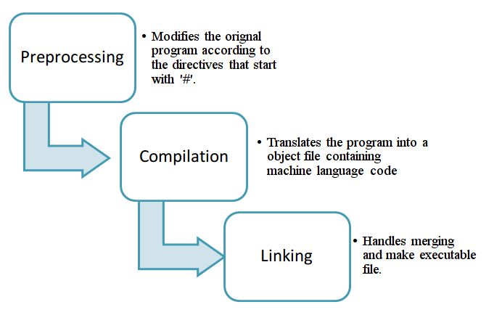

Slide 42
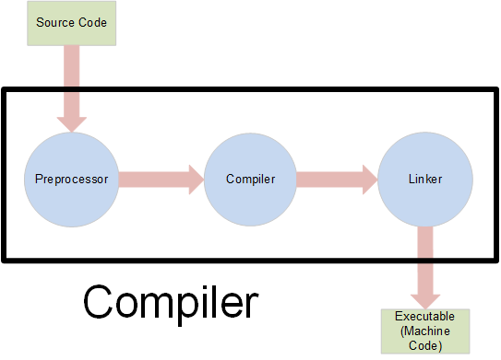
Source code -> cmpiler -> Assembler -> Object code -> Linker -> Executable file

Slide 43
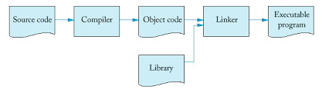
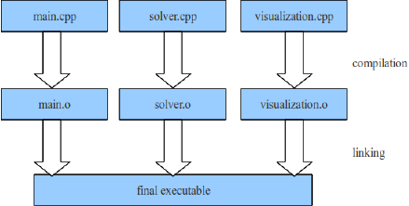

Slide 44
Linker : The linker is a program that makes executable files.
A linker is a computer utility program that takes one or more object files generated by a compiler or an assembler and combines them into a single executable file.
Linking:
The process of connecting or combining object files produced by a compiler with the libraries necessary to make a working executable program is called linking.

Slide 45
Manipulators
Manipulators are instructions to the out stream that modify the output in various ways.
endl manipulator causes a linefeed to be inserted into the stream, so that subsequent text will be displayed on the next line.
setw manipulator: changes the field width of the output. i.e each value displayed will occupy a field (an imaginary box) with a certain width.
setw syntax
cout<<setw(8) <<“population”;

Slide 46
Comments
Comments are important point of any program.
Programmers use comments to tell the purpose of the program and to improve the program’s readability.
Comment syntax
Comments start with a double slash //
Examples:

Slide 47
Escape Sequences
Are special characters , they don’t appear on the screen rather their effect can be seen.
Escape Sequence Description
\n Newline. Position the screen cursor to the beginning of the next line.
\t Horizontal tab. Move the screen cursor to the next tab stop.
\r Carriage return. Position the screen cursor to the beginning of the current line; do not advance to the next line. Any characters output after the carriage return overwrite the characters previously output on that line.
\\ Backslash. Used to print a backslash character.
\’ Single quote.
\" Double quote. Used to print a double-quote character. For example,
Cout<<"\"in quotes\"" ; // displays
"in quotes"

Slide 48
Generation of Programming Languages
There are five generation of Programming languages. They are: First Generation Languages : These are low-level languages like machine language.
Second Generation Languages : These are low-level assembly languages used in kernels and hardware drives.
Third Generation Languages : These are high-level languages like C, C++, Java, Visual Basic and JavaScript.
Fourth Generation Languages : These are languages that consist of statements that are similar to statements in the human language. These are used mainly in database programming and scripting. Example of these languages include Perl, Python, Ruby, SQL, MatLab (Matrix Laboratory).
Fifth Generation Languages : These are the programming languages that have visual tools to develop a program. Examples of fifth generation language include Mercury, OPS5, and Prolog.
The first two generations are called low level languages. The next three generations are called high level languages.

Slide 49
Software compatibility is a characteristic of software components or systems which can operate satisfactorily (properly, all right) on a computer.
Compatible software
software that can run on different computers without modification.
Software incompatibility is a characteristic of software components or systems which cannot operate satisfactorily (properly, all right) on a computer.
It is possible that some software components or systems may be compatible in one environment and incompatible in another.

Slide 50
return statement
The return statement is used to return the control to another portion in the program or to the operating system.
In this program, the return statement returns the value from the main function to the operating system.
When a Zero is returned to the operating system, it assumes that the program has executed Normally(Successfully).

